Slide 1



Noida Institute of Engineering and Technology, Greater Noida
Multivariable Calculus
Unit: 1
MATHEMATICAL FOUNDATION – II
Dr. Akansha Singh
Affiliation from AKTU, Lucknow
Mathematics Department
B Tech 2nd Sem

Slide 2
Content
Multiple integration: Double integral, Triple integral
Change of order of integration
Change of variables
Application: Areas and volumes, Center of mass (Constant and variable densities)
Improper Integral
Beta and Gama function
Dirichlet’s Integral and its applications.

Slide 3
Course Objective
The objective of this course is to familiarize the engineering students with techniques of solving matrices, differential calculus, multivariable calculus problems. It aims to equip the students with adequate knowledge of mathematics that will enable them in formulating problems and solving problems analytically.

Slide 4
Unit Objective
The use of multiple integral in finding area, volume, mass, centroid and moment of inertia of plane and solid regions.
The students will learn the essential concepts of multiple integration (Double integral, Triple integral), Change of order of integration, Change of variables, Areas and volumes, Center of mass and center of gravity (Constant and variable densities), in a comprehensive manner.

Slide 5
Course Outcomes 2020-21 (B. Tech. – 2nd Sem)
Course Name: Mathematical Foundation-II
CO1 | Apply multiple integral to find area and volume.
CO2 | Apply the concept of differentiation to solve differential equations.
CO3 | Illustrate the solution of partial differential equation of second order.
CO4 | Apply the Laplace transform to solve ordinary differential equations
CO5 | Demonstrate the basic concept Proportion & Partnership, Problem of ages, Allegation & Mixture, Direction, Blood relation , Simple & Compound interest

Slide 6
Program Outcomes (PO)
Engineering knowledge: Apply the knowledge of mathematics, science, engineering fundamentals, and an engineering specialization to the solution of complex engineering problems.
2. Problem analysis: Identify, formulate, review research literature, and analyze complex engineering problems reaching substantiated conclusions using first principles of mathematics, natural sciences, and engineering sciences.
3. Design/development of solutions: Design solutions for complex engineering problems and design system components or processes that meet the specified needs with appropriate consideration for the public health and safety, and the cultural, societal, and environmental considerations.
4. Conduct investigations of complex problems: Use research-based knowledge and research methods including design of experiments, analysis and interpretation of data, and synthesis of the information to provide valid conclusions.

Slide 7
Program Outcomes (PO)
5. Modern tool usage: Create, select, and apply appropriate techniques, resources, and modern engineering and IT tools including prediction and modeling to complex engineering activities with an understanding of the limitations.
6. The engineer and society: Apply reasoning informed by the contextual knowledge to assess societal, health, safety, legal and cultural issues and the consequent responsibilities relevant to the professional engineering practice.
7. Environment and sustainability: Understand the impact of the
professional engineering solutions in societal and environmental
contexts, and demonstrate the knowledge of, and need for sustainable
development.
8. Ethics: Apply ethical principles and commit to professional ethics and
responsibilities and norms of the engineering practice.

Slide 8
Program Outcomes (PO)
9. Individual and team work: Function effectively as an individual, and as
a member or leader in diverse teams, and in multidisciplinary settings.
10.Communication: Communicate effectively on complex engineering
activities with the engineering community and with society at large,
such as, being able to comprehend and write effective reports and
design documentation, make effective presentations, and give and
receive clear instructions.
11.Project management and finance: Demonstrate knowledge and
understanding of the engineering and management principles and
apply these to one’s own work, as a member and leader in a team,
to manage projects and in multidisciplinary environments.
12. Life-long learning: Recognize the need for, and have the preparation
and ability to engage in independent and life-long learning in the
broadest context of technological change.

Slide 9
CO-PO Mapping 2020-21 (B. Tech. – 2nd Sem)
Course Name: Mathematical Foundation-II
CO | PO-1 | PO-2 | PO-3 | PO-4 | PO-5 | PO-6 | PO-7 | PO-8 | PO-9 | PO-10 | PO-11 | PO-12
CO1 | 3 | 2 | 1 | 1 | 3 | 2 | - | - | - | 2 | 2 | 3
CO2 | 3 | 3 | 2 | 3 | 3 | - | - | - | - | 2 | 3 | 3
CO3 | 3 | 2 | 3 | 3 | 3 | 2 | - | - | - | 2 | 3 | 3
CO4 | 3 | 2 | 3 | 3 | 2 | 2 | - | - | - | 2 | 2 | 3
CO5 | 1 | 1 | 1 | 1 | 1 | - | - | - | - | 2 | - | 3
Mean | 2.6 | 2 | 2 | 2.2 | 2.4 | 2.0 | - | - | - | 2 | 2.5 | 3

Slide 10
Prerequisite and Recap
Function of one and two variables
Basic knowledge of differentiation and integration

Slide 11
Topic Objective
Multiple Integral (CO 1)
Student will be able to evaluate multiple Integrals that are used to evaluate area, volume, mass, moment of inertia of plane & solid region.

Slide 12
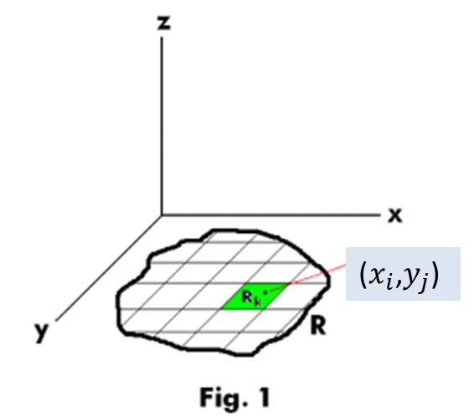
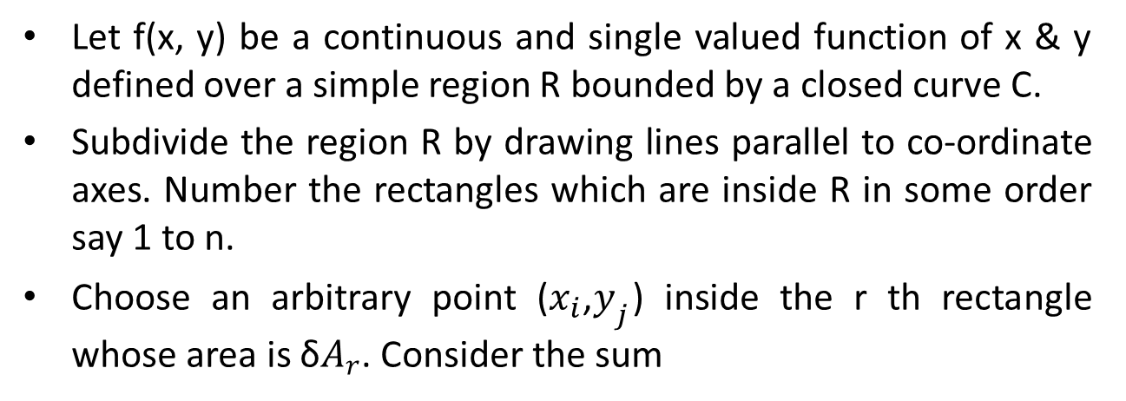
Double Integral (CO 1)
Let f(x, y) be a continuous and single valued function of x & y defined over a simple region R bounded by a closed curve C.
Subdivide the region R by drawing lines parallel to co-ordinate axes. Number the rectangles which are inside R in some order say 1 to n.
Choose an arbitrary point ($x_{i}$,$y_{j}$) inside the r th rectangle whose area is δ$A_{r}$. Consider the sum

Slide 13
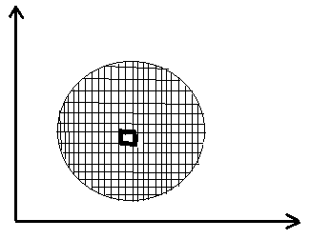
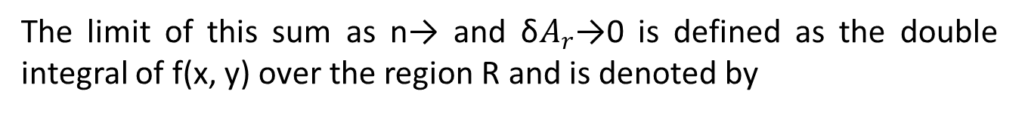
Evaluation of Double Integration (CO 1)
The limit of this sum as n→ and δ$A_{r}$→0 is defined as the double integral of f(x, y) over the region R and is denoted by

Slide 14
Evaluation of Double Integration (CO 1)
CASE I :
Let the region R be the rectangular region expressed in the form
In this case the limits, both for x and y is constants, so it is immaterial
whether we first integrate w.r.t. x, or w.r.t. y.
Note: The two approaches yield the same answer.

Slide 15
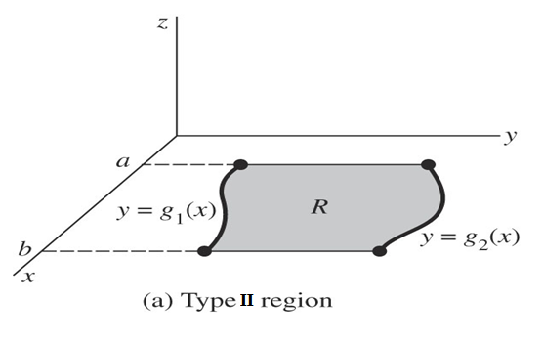
Evaluation of Double Integration (CO 1)
CASE 2 :
Let the region R be expressed in the form
In this case the limits of x are constants, but for y limits are as functions of x, so here we first integrate w.r.t.y and then w.r.t.x. Thus

Slide 16
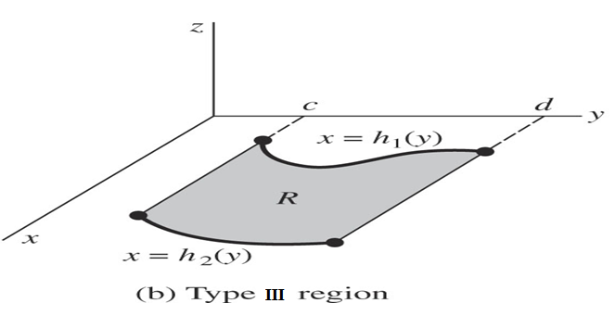
Evaluation of Double Integration (CO 1)
CASE 3 :
Let the region R be expressed in the form
In this case the limits of y are constants, but for x limits are as functions of y, so here we first integrate w. r. to x and then w.r.to y. Thus

Slide 17
Triple Integral (CO 1)
Now we know that how to integrate over a two-dimensional region. We’ll use triple integral to integrate over a three dimensional region. The notation for the general triple integrals is
CASE 1: If the limits of x, y, z all are constants-
CASE 2: The limits involving two variables are kept innermost, and then limit involving one variable and finally the constant limits.

Slide 18
Example 1
Question:
Solution:

Slide 19
Example 2
Question:
Solution:

Slide 20
Example 3
Question:
Solution:

Slide 21
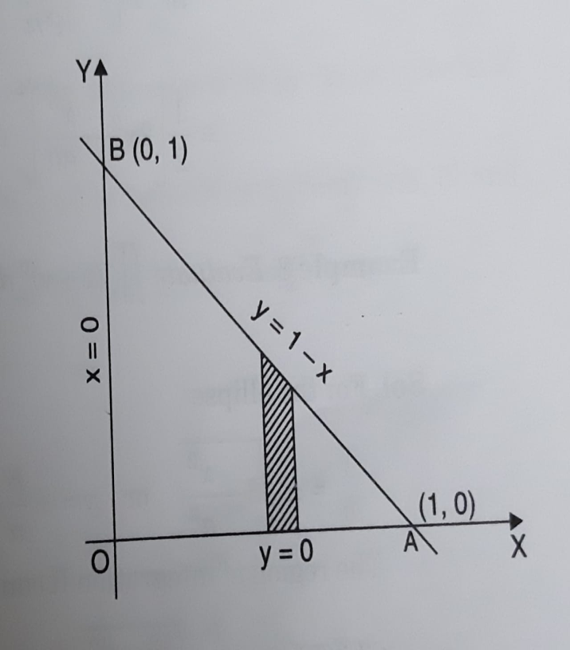
Example 4
Question:
Solution:

Slide 22
Example 4 Contd…

Slide 23
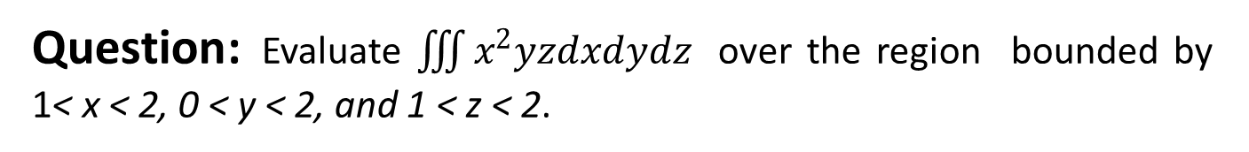
Example 5
Question: Evaluate $\iiint{x^{2}yzdxdydz }$over the region bounded by 1< x < 2, 0 < y < 2, and 1 < z < 2.
Solution:

Slide 24
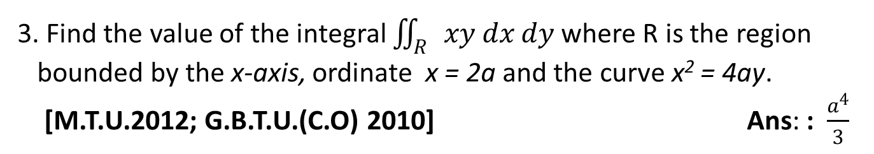
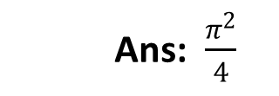
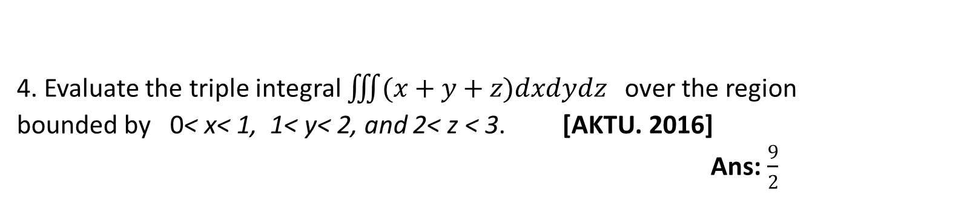
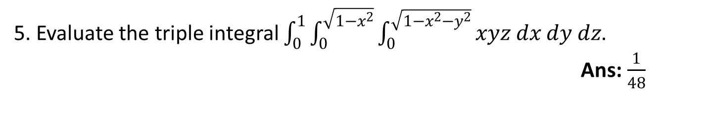
FAQ
1. Evaluate $\int_{0}^{1}{\int_{y^{2}}^{y}{\left(1+xy^{2}\right) dx dy}}$ [G.B.T.U. 2010] Ans:$\frac{41}{210}$
Ans: $\frac{π^{2}}{4}$
3. Find the value of the integral $\iint_{R}{xy dx dy}$ where R is the region
bounded by the x-axis, ordinate x = 2a and the curve x² = 4ay.
[M.T.U.2012; G.B.T.U.(C.O) 2010] Ans: :$\frac{a^{4}}{3}$
4. Evaluate the triple integral $\iiint{(x+y+z)dxdydz }$over the region bounded by 0< x< 1, 1< y< 2, and 2< z < 3.[AKTU. 2016]
Ans:$\frac{9}{2}$
5. Evaluate the triple integral $\int_{0}^{1}{\int_{0}^{\sqrt{1−x^{2}}}{\int_{0}^{\sqrt{1−x^{2}−y^{2}}}{xyz dx dy dz}}}$.
Ans:$\frac{1}{48}$

Slide 25
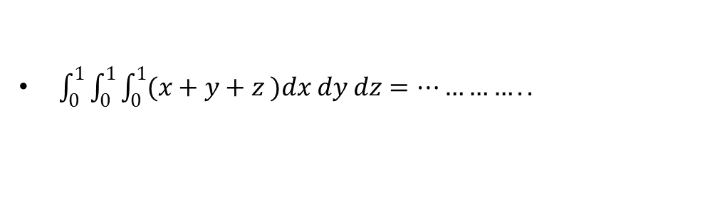
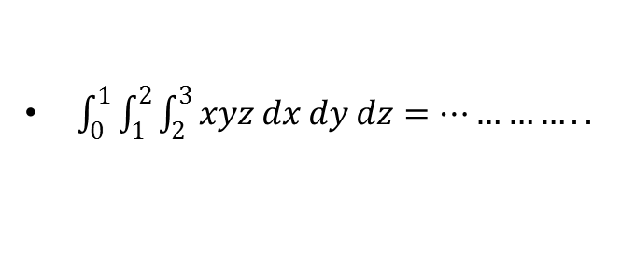
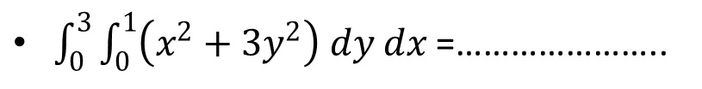
Quiz
$\int_{0}^{3}{\int_{0}^{1}{\left(x^{2}+3y^{2}\right) dy dx}}$ =…………………..
$\int_{0}^{1}{\int_{0}^{1}{\int_{0}^{1}{(x+y+z )dx dy dz}}}=…………..$
$\int_{0}^{1}{\int_{1}^{2}{\int_{2}^{3}{xyz dx dy dz}}}=…………..$

Slide 26
Faculty Video Links, Youtube & NPTEL Video Links and Online Courses Details
Double Integral
NPTEL: Lecture 17 – Double Integral
https://www.youtube.com/watch?v=3BbrC9JcjOU
NPTEL: Lecture 30 – Double Integral
https://www.youtube.com/watch?v=-DduB46CoZY
Triple Integral
NPTEL: Lecture 22– Triple Integral
https://www.youtube.com/watch?v=VvKAuFBJLs0

Slide 27
Recap
Double Integral
Triple Integral

Slide 28
Topic Objective
Change of order of integration (CO 1)
Students will be able to evaluate integral by change of order of integration.
Sometimes evaluation of double integral become easier by changing the order of integration. e.g.

Slide 29
Change of order of integration (CO 1)
To change the order of integration first, draw the region of integration with the help of limits of integration.
Secondly, draw vertical or horizontal strips as per the required order of integration.

Slide 30
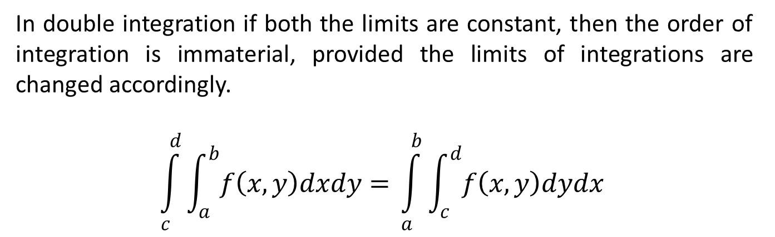
Change of order of integration (CO 1)
Case 1: If both the limits are constant
In double integration if both the limits are constant, then the order of integration is immaterial, provided the limits of integrations are changed accordingly.
$$\int_{c}^{d}{\int_{a}^{b}{f\left(x,y\right)dxdy= }}\int_{a}^{b}{\int_{c}^{d}{f\left(x,y\right)dydx }}$$

Slide 31
Change of order of integration (CO 1)
Case 2: Suppose the limits for inner integration are functions of any variable
Identify the region of integration of double integration.
Convert the given double integral into its equivalent double integral by changing the order of integration.
Find the new limits of integration.
After finding the new limits, evaluate the integral.

Slide 32
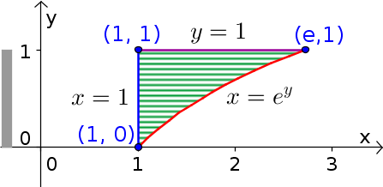
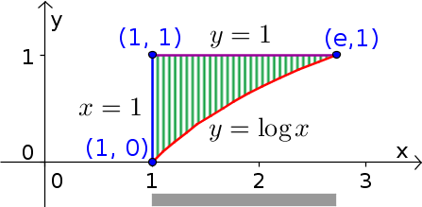
Example 1
Question: Change the order of integration
Solution:
First we draw the limits of integral. Here limit of x is in
variable terms and limits of y are constant (horizontal strip). So for changing order we consider vertical strip .

Slide 33
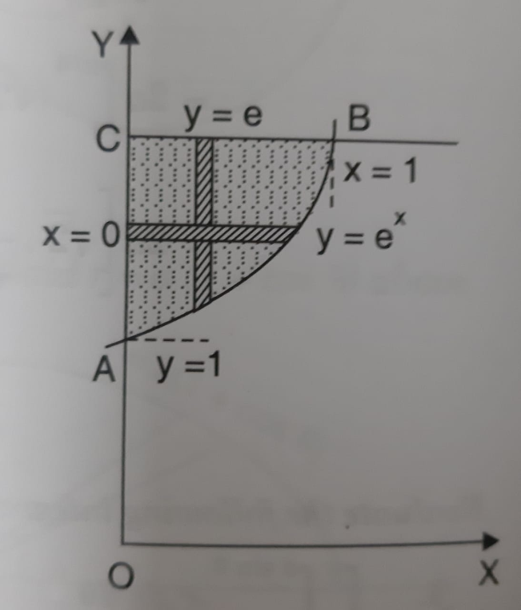
Example 2
Question: Change the order of integration
Solution:
According to given limits region bounded by following curves:
It can also be considered as bounded by following curves:

Slide 34
Example 2 Contd…

Slide 35
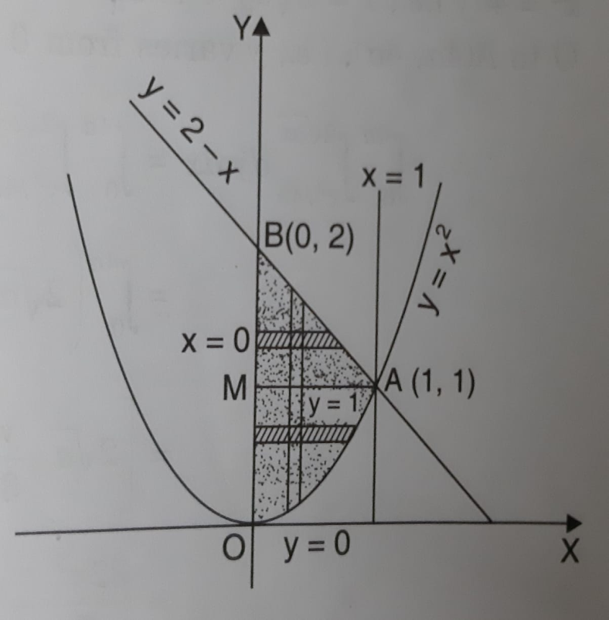
Example 3
Question: Change the order of integration and evaluate
Solution:
According to given limits region bounded by following curves:

Slide 36
Example 3 Contd…

Slide 37
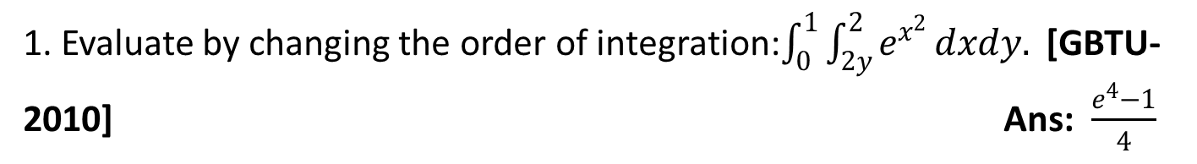
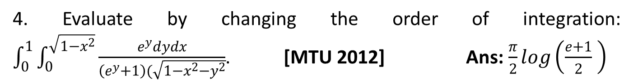
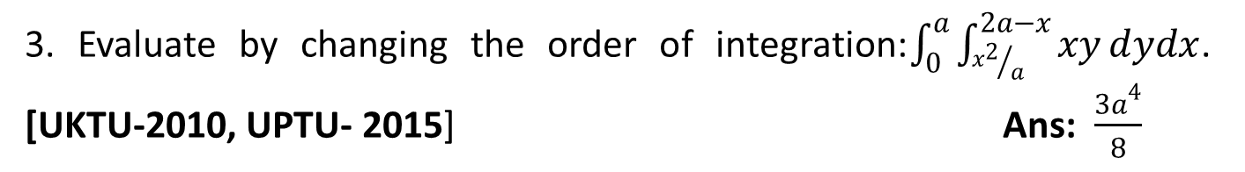
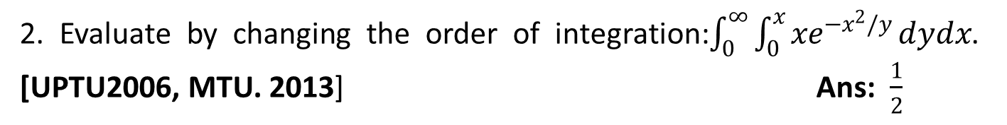
FAQ
1. Evaluate by changing the order of integration:$\int_{0}^{1}{\int_{2y}^{2}{e^{x^{2}}}}dxdy.$[GBTU-2010] Ans: $\frac{e^{4}−1}{4}$
2. Evaluate by changing the order of integration:$\int_{0}^{∞}{\int_{0}^{x}{{xe}^{{−x}^{2}/y}}}dydx$. [UPTU2006, MTU. 2013] Ans:$\frac{1}{2}$
3. Evaluate by changing the order of integration:$\int_{0}^{a}{\int_{{x^{2}}/a}^{2a−x}{xy}}dydx$. [UKTU-2010, UPTU- 2015] Ans: $\frac{{3a}^{4}}{8}$
4. Evaluate by changing the order of integration:$\int_{0}^{1}{\int_{0}^{\sqrt{1−x^{2}}}{\frac{e^{y}dydx}{\left(e^{y}+1\right)(\sqrt{1−x^{2}−y^{2}}}}}$. [MTU 2012] Ans: $\frac{π}{2}log\left(\frac{e+1}{2} \right)$

Slide 38

Quiz
After changing order $\int_{0}^{1}{\int_{2y}^{2}{e^{x^{2}}}}dxdy$imits are………………..
After changing order $\int_{0}^{a}{\int_{{x^{2}}/a}^{2a−x}{xy}}dydx$limits are………………..
After changing order $\int_{0}^{a}{\int_{0}^{\sqrt{a^{2}−y^{2}}}{(x^{2}+y^{2})}}dxdy$ limits are………………..

Slide 39
Faculty Video Links, Youtube & NPTEL Video Links and Online Courses Details
Change of order of integration
NPTEL: Lecture 21– Change of order of integration
https://www.youtube.com/watch?v=4rc3w1sGoNU

Slide 40
Recap
Change of order of integration
Evaluate integrals

Slide 41
Topic Objective
Change of Variables in Multiple Integrals (CO 1)
Students will be able to understand the concepts of change of variables.
When solving integration problems, we make appropriate substitutions to obtain an integral that becomes much simpler than the original integral.
Students will transforme double integrals in rectangular coordinates to polar coordinates and transformed triple integrals in rectangular coordinates to cylindrical or spherical coordinates to make the computations simpler.

Slide 42
Change of Variables in Multiple Integrals (CO 1)
Let the variables x, y be replaced by new variables u, v by the transformation
then

Slide 43
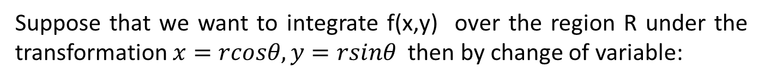
Change of Variables Polar Form (CO 1)
Suppose that we want to integrate f(x,y) over the region R under the transformation $x=rcosθ, y=rsinθ$ then by change of variable:
then

Slide 44
Change of Variables Spherical Form (CO 1)
Suppose that we want to integrate f(x,y,z) over the region V under the transformation Cartesian to spherical form:
then

Slide 45
Change of Variables Cylindrical Form (CO 1)
Suppose that we want to integrate f(x,y,z) over the region V under the transformation Cartesian to cylindrical form:
then

Slide 46
Example 1
Question:
Solution:

Slide 47
Example 1 Contd..

Slide 48
Example 2
Question:
Solution:

Slide 49
Example 2 Contd..

Slide 50
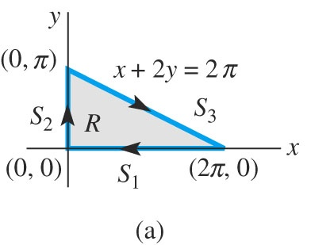
Example 3
Question:
Solution:
Let x+2y=u and x-2y=v

Slide 51
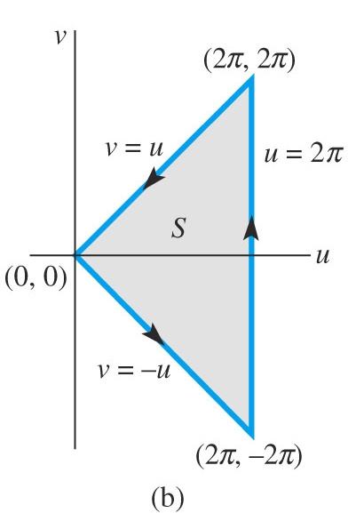
The Jacobian matrix is
Example 3 Contd…

Slide 52
Example 3 Contd…

Slide 53
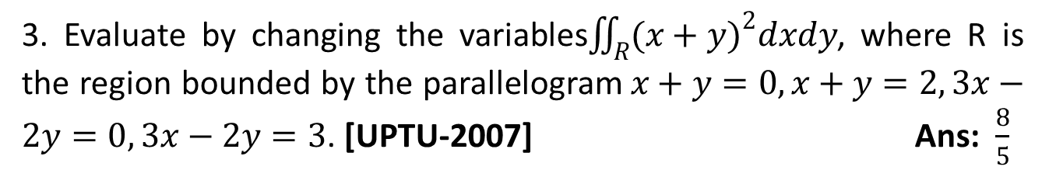
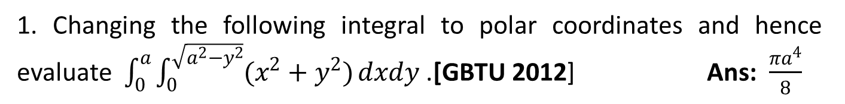
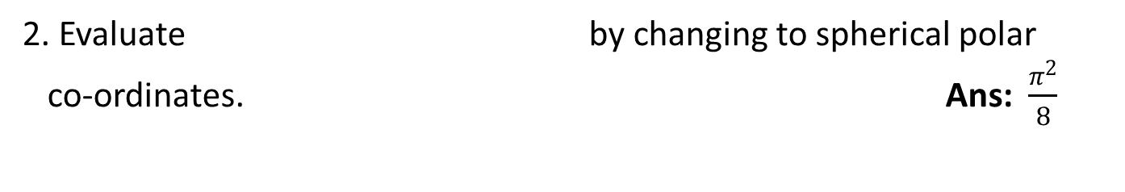
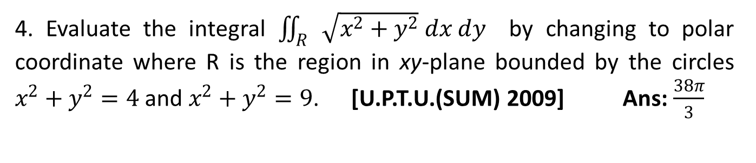
FAQ
1. Changing the following integral to polar coordinates and hence evaluate $\int_{0}^{a}{\int_{0}^{\sqrt{a^{2}−y^{2}}}{(x^{2}+y^{2})}}dxdy$.[GBTU 2012] Ans: $\frac{{πa}^{4}}{8}$
2. Evaluate by changing to spherical polar
co-ordinates. Ans: $\frac{π^{2}}{8}$
3. Evaluate by changing the variables$\iint_{R}^{ }{{(x+y)}^{2}dxdy}$, where R is the region bounded by the parallelogram$x+y=0,x+y=2, 3x−2y=0, 3x−2y=3$. [UPTU-2007]Ans: $\frac{8}{5}$
4. Evaluate the integral $\iint_{R}{\sqrt{x^{2}+y^{2}} dx dy}$ by changing to polar coordinate where R is the region in xy-plane bounded by the circles $x^{2}+y^{2}=4$ and $x^{2}+y^{2}=9$. [U.P.T.U.(SUM) 2009] Ans:$\frac{38π}{3}$

Slide 54
Quiz
Replace x with …………………. in changing Cartesian to polar form .
Replace z with …………………. in changing Cartesian to spherical polar form .
C$hange the variable into polar form\int_{0}^{a}{\int_{0}^{\sqrt{a^{2}−y^{2}}}{(x^{2}+y^{2})}}dxdy$

Slide 55
Faculty Video Links, Youtube & NPTEL Video Links and Online Courses Details
Change of variable
NPTEL: Lecture 11– Change of variables
https://www.youtube.com/watch?v=X6kp2o3mGtA&t=1003s
NPTEL: Lecture 22– Change of variables in multiple integral
https://www.youtube.com/watch?v=wtY5fx6VMGQ&t=1151s
NPTEL: Lecture 35– Triple integrals
https://www.youtube.com/watch?v=-I3HUeHi1Ys&t=1933s

Slide 56
Recap
Change of variables
Polar form
Spherical form
Cylindrical form

Slide 57
Topic Objective
Applications: Area and Volume (CO 1)
In engineering, volume and area are very important. With this students can figure out density, capacitance, flux, and many other things.
One very useful application of Integration is finding the area and volume of “curved” figures, that we couldn’t typically get without using Calculus.

Slide 58
Applications: Area and Volume (CO 1)
Area as a Double integration:
Area of region R for Cartesian co-ordinates:
Volume as a Triple integration:
Volume V of region for Cartesian co-ordinates :

Slide 59
Applications: Centre of Mass (CO 1)
Centre of mass:
For a region R of a lamina with given density:

Slide 60
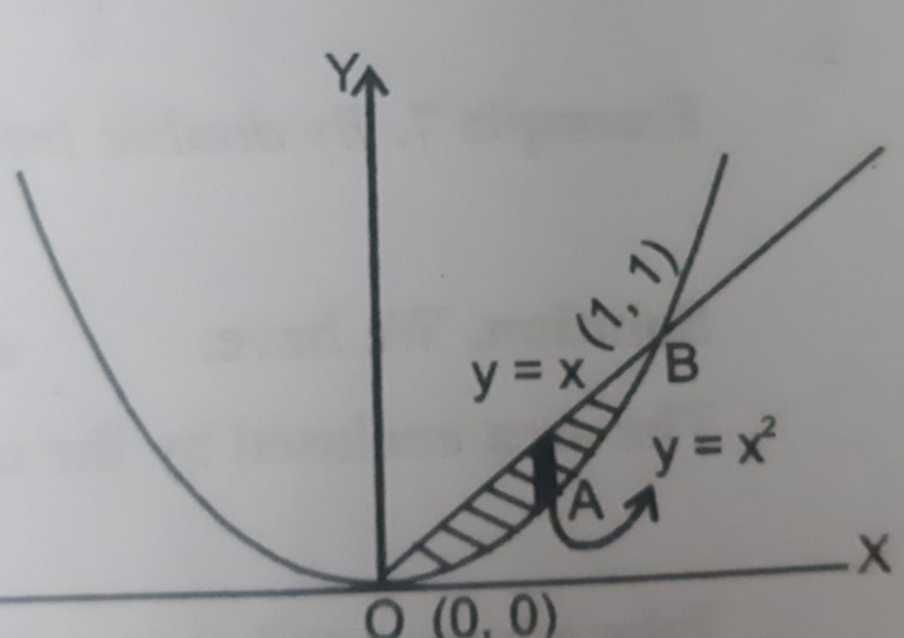
Example 1
Question:
Solution:

Slide 61
Example 1 Contd…

Slide 62
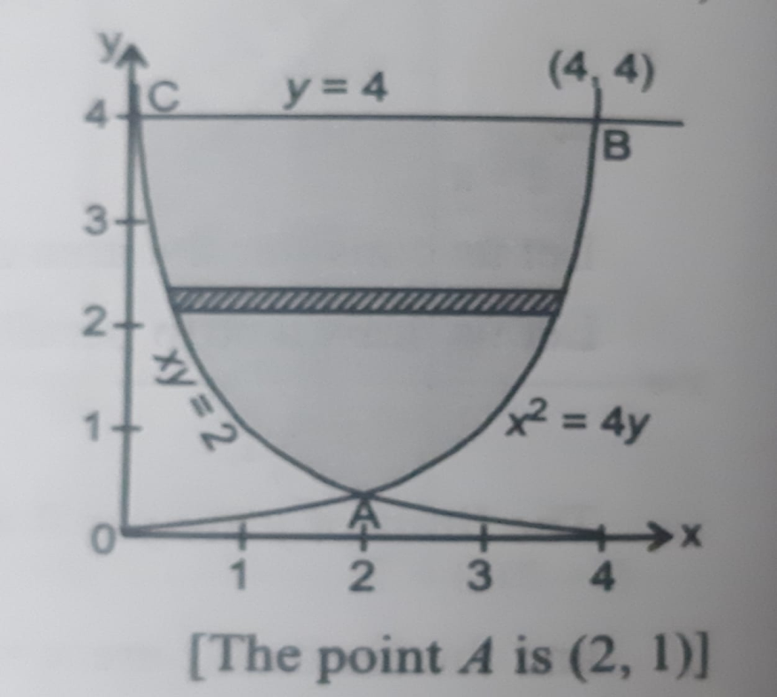
Example 2
Question:
Solution:

Slide 63
Example 2 Contd…

Slide 64
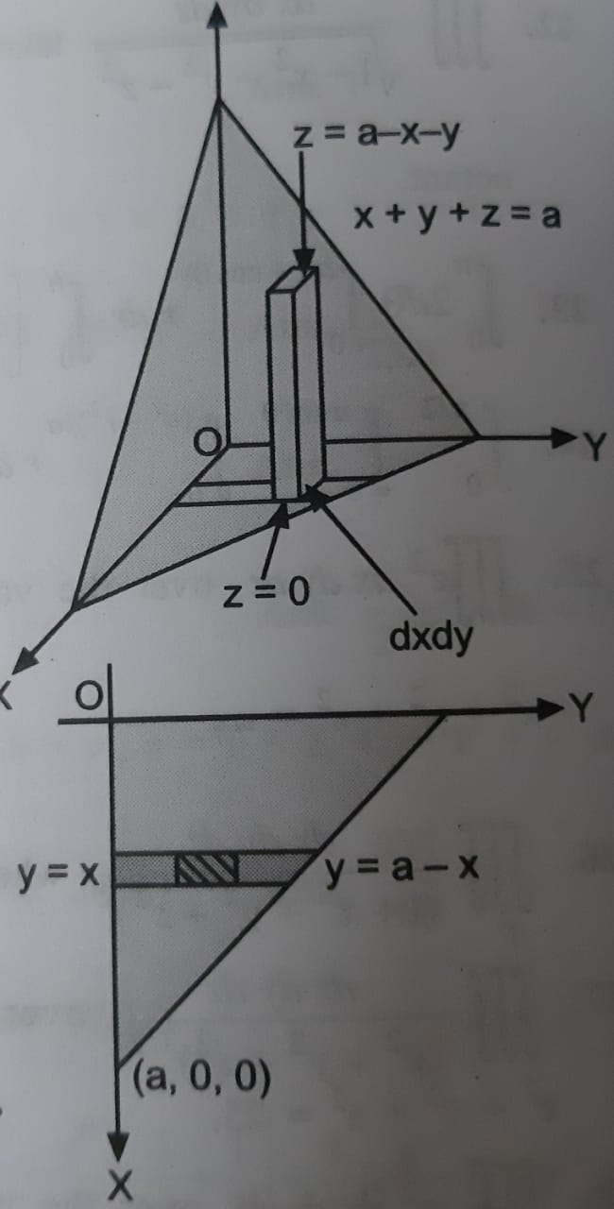
Example 3
Question:
Solution:

Slide 65
Example 3 Contd…

Slide 66
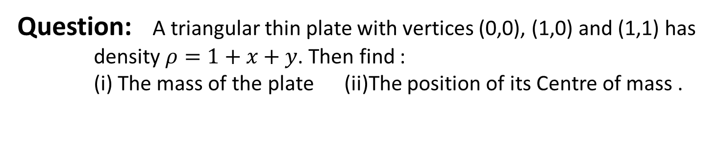
Example 4
Question: A triangular thin plate with vertices (0,0), (1,0) and (1,1) has
density $ρ=1+x+y$. Then find :
(i) The mass of the plate (ii)The position of its Centre of mass .
Solution:

Slide 67
Example 4 Contd…

Slide 68
Example 4 Contd…

Slide 69
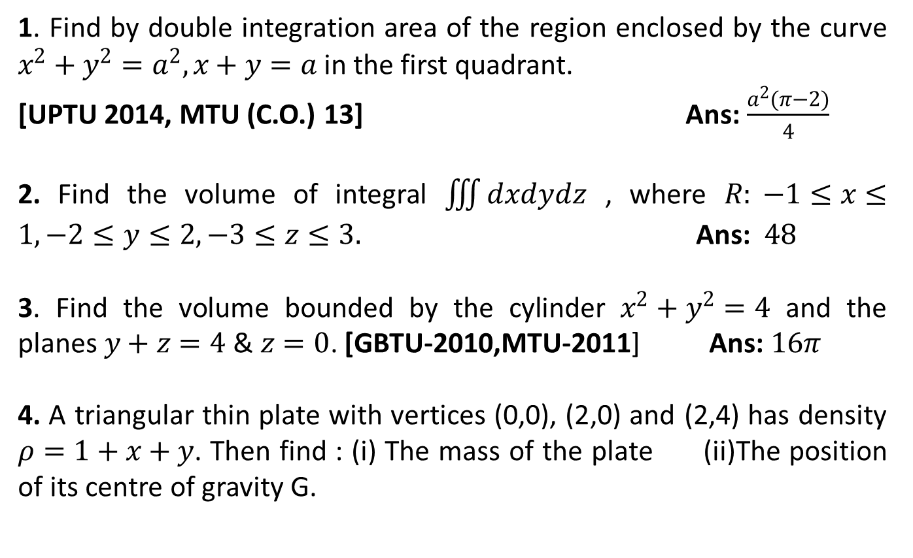
FAQ
1. Find by double integration area of the region enclosed by the curve $x^{2}+y^{2}=a^{2}, x+y=a$in the first quadrant.
[UPTU 2014, MTU (C.O.) 13]Ans: $\frac{a^{2}(π−2)}{4}$
2. Find the volume of integral $\iiint{dxdydz}$ , where $R: −1≤x≤1,−2≤y≤2,−3≤z≤3.$Ans: $48$
3. Find the volume bounded by the cylinder $x^{2}+y^{2}=4$ and the planes $y+z=4$&$z=0$. [GBTU-2010,MTU-2011] Ans:$16π$
4. A triangular thin plate with vertices (0,0), (2,0) and (2,4) has density $ρ=1+x+y$. Then find : (i) The mass of the plate (ii)The position of its centre of gravity G.

Slide 70
Quiz
Area enclosed between the parabola y = x² and the straight line y = x is………..
If a circle x² +y² =a² is rotated about x axis the volume is………
Area of ellipse is………..

Slide 71
Faculty Video Links, Youtube & NPTEL Video Links and Online Courses Details
Area and Volume
NPTEL: Lecture 20 – Multiple Integral
https://www.youtube.com/watch?v=mIeeVrv447s
Volume as triple integral
https://www.youtube.com/watch?v=mIpQYY3uzT4
Centre of Mass
Double integral finding mass and center of mass
https://www.youtube.com/watch?v=yJDRwKGfKD

Slide 72
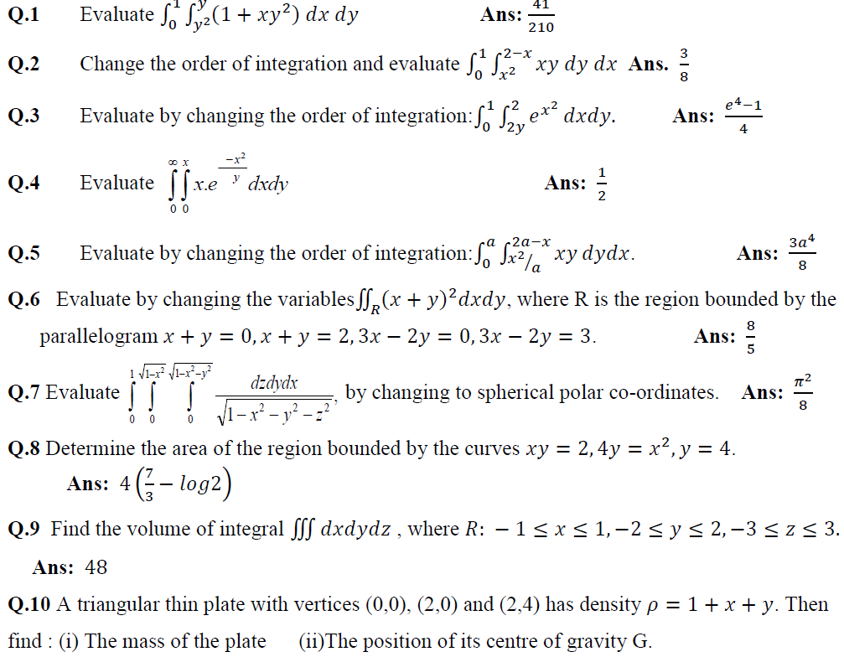
Weekly Assignment 1 (CO 1)

Slide 73
Recap
Application of integrals
Area
Volume
Centre of mass
Discussion on assignment

Slide 74
Improper Integral (CO 1)

Slide 75
Improper Integral of First Kind (CO 1)
The definite integral is called an improper integral of first kind if either a or b or both a and b are infinite. For example:

Slide 76
Improper Integral of Second Kind (CO 1)
The definite integral is called an improper integral of second kind if both a and b are finite but integrand becomes infinite at some point of the range.

Slide 77
Improper Integral of Third Kind (CO 1)
The definite integral is called an improper integral of third kind if interval of integration is unbounded and f is also unbounded. For example

Slide 78
Example 1
Question:
Solution:

Slide 79
Example 2
Question:
Solution:

Slide 80
Example 3
Question:
Solution:

Slide 81
Topic Objective
Beta and Gamma Function (CO 1)
Students will be able to understand the concepts of beta and Gamma function and solve integration by using them .
Many complex integrals can be reduced to expressions involving the beta and Gamma function.

Slide 82
Gamma Function (CO 1)
Properties of Gamma Function

Slide 83
Transformations of Gamma Function (CO 1)
Transformation 1:
Transformation 2:
Transformation 3:

Slide 84
Beta Function (CO 1)
Properties of Beta Function

Slide 85
Transformations of Beta Function (CO 1)
Transformation 1:
Transformation 2:

Slide 86
Important Results (CO 1)
1. Relation between Beta and Gamma function:
2.
3.
4. Duplication Formula:

Slide 87
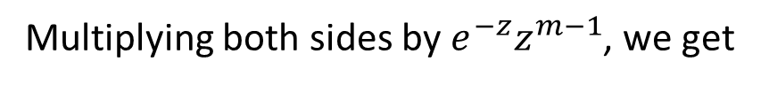
Relation : Beta and Gamma Function (CO 1)
Proof:
By Gamma fn. First transformation
Replace k by z
Multiplying both sides by $e^{−z}z^{m−1}$, we get

Slide 88
Relation : Beta and Gamma Function (CO 1)

Slide 89
Relation : Beta and Gamma Function (CO 1)

Slide 90
Example 1
Question:
Solution:

Slide 91
Example 2
Question:
Solution:

Slide 92
Example 3
Question:
Solution:

Slide 93
Example 4
Question:
Solution:

Slide 94
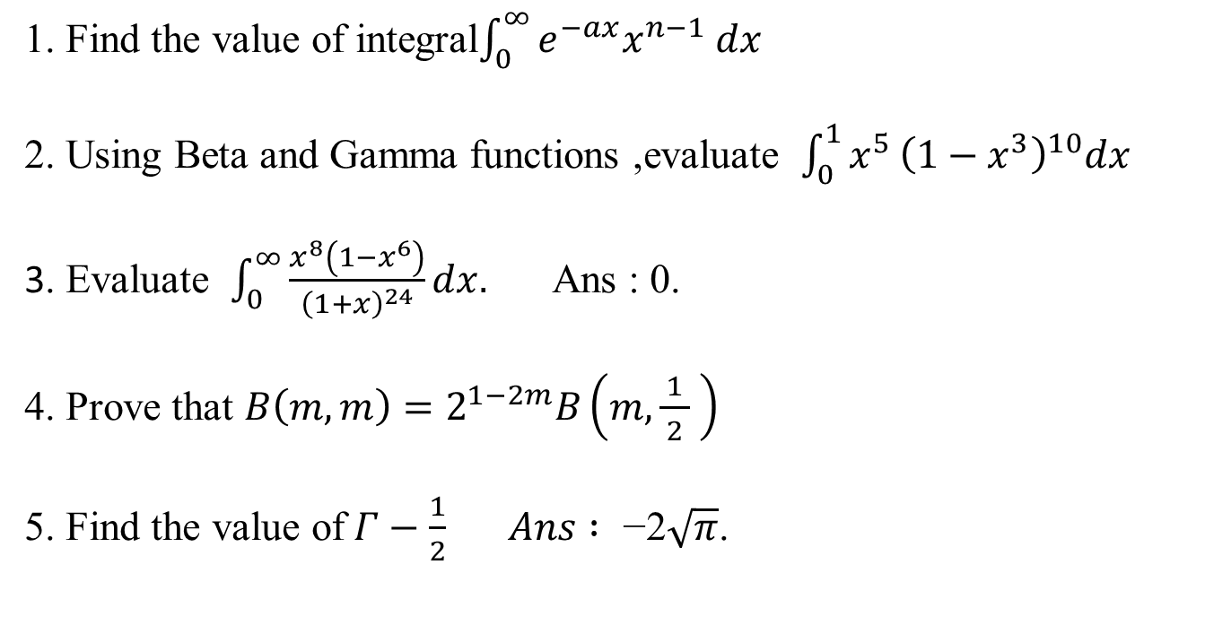
FAQ
1. Find the value of integral$\int_{0}^{∞}{e^{−ax}x^{n−1} dx}$
2. Using Beta and Gamma functions ,evaluate $\int_{0}^{1}{x^{5}}{\left(1−x^{3}\right)}^{10}dx$
3. Evaluate $\int_{0}^{∞}{\frac{x^{8}\left(1−x^{6}\right)}{{\left(1+x\right)}^{24}}}dx.$ Ans : 0.
4. Prove that $B\left(m,m\right)=2^{1−2m}B\left(m,\frac{1}{ 2 } \right)$
5. Find the value of$Γ−\frac{1}{2} Ans :\text{ −2}\sqrt{π}$.

Slide 95
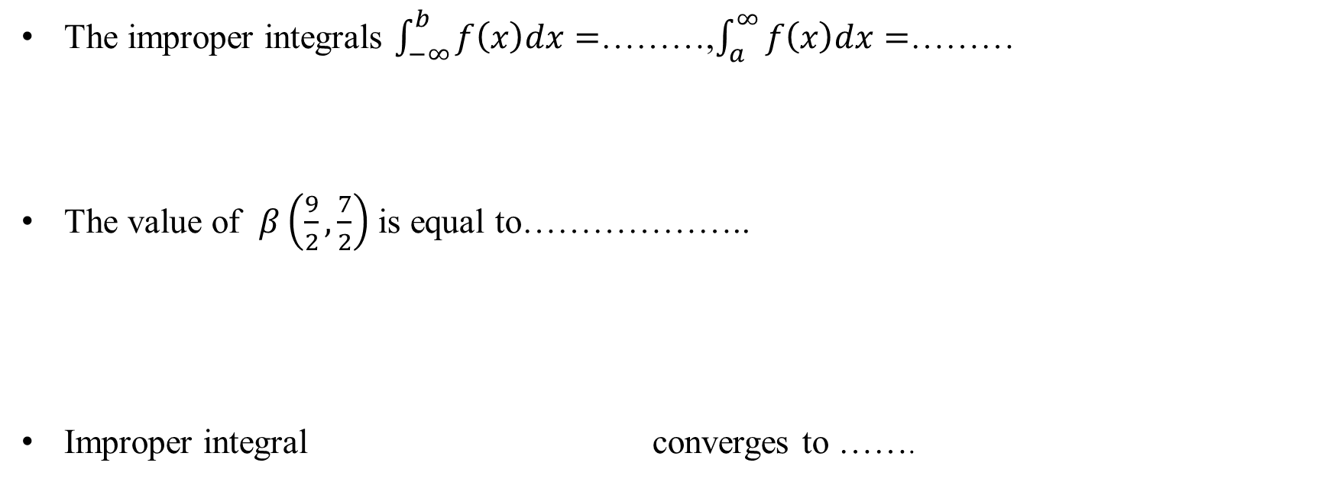
Quiz
The improper integrals $\int_{−∞}^{b}{f\left(x\right)dx}=$………,$\int_{a}^{∞}{f\left(x\right)dx=}$………
The value of $β\left(\frac{9}{2},\frac{7}{2}\right)$ is equal to………………..
Improper integral converges to …….

Slide 96
Faculty Video Links, Youtube & NPTEL Video Links and Online Courses Details
Self Made Video Link
Improper Integral
https://www.youtube.com/watch?v=obZ-xUL4S9g&t=152s
Beta and Gamma Function
https://www.youtube.com/watch?v=A_QE-duLhW0&t=904s
Youtube/other Video Links
Improper Integral
NPTEL: Lecture 21-Improper Integral
https://www.youtube.com/watch?v=kfv9h3c46CI
Beta and Gamma Function
NPTEL: Lecture Beta and Gamma Function
https://www.youtube.com/watch?v=9_m36W3cK74

Slide 97
Recap
Improper Integral
Gamma Function
Beta Function

Slide 98
Topic Objective
Dirichlet’s Integral (CO 1)
Students will be able to understand the term "Dirichlet integral.“
Useful in finding volume and mass.

Slide 99
Dirichlet’s Integral (CO 1)
where V is the region x ≥ 0, y ≥ 0 ,z ≥ 0 and x + y +z ≤1

Slide 100
Example 1
Question:
Solution: Let

Slide 101
Example 2
Question:
Solution:

Slide 102
Example 2 Contd…

Slide 103
Example 3
Question:
Solution:
Solution: Let

Slide 104
Example 3 Contd…

Slide 105
FAQ

Slide 106
Quiz
Dirichlet’s integral applied when…………

Slide 107
Faculty Video Links, Youtube & NPTEL Video Links and Online Courses Details
Self Made Video Link
Dirichlet’s Integral
https://www.youtube.com/watch?v=NDYVmthtWeQ&t=487s
Volume and Surface of Solid of Revolution
https://www.youtube.com/watch?v=Ej789u59JwM&t=263s
Youtube/other Video Links
Dirichlet’s Integral
IIT: Lecture- Dirichlet’s Integral
https://www.youtube.com/watch?v=HQM7XMd5QQo

Slide 108
Recap
Dirichlet’s Integral

Slide 109
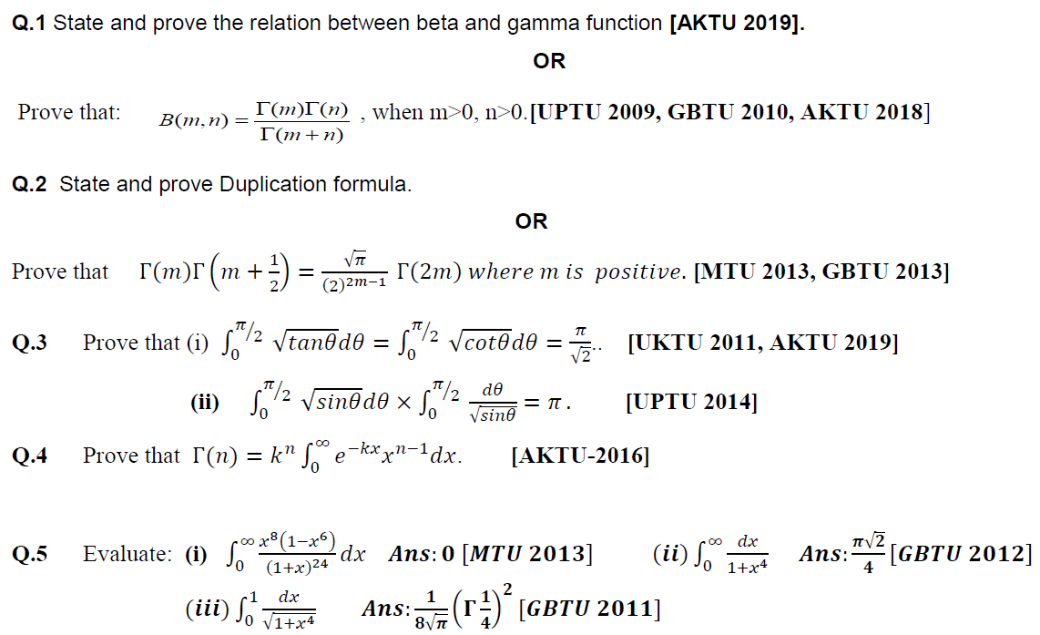
Weekly Assignment 2 (CO 1)
Beta and Gamma Function

Slide 110
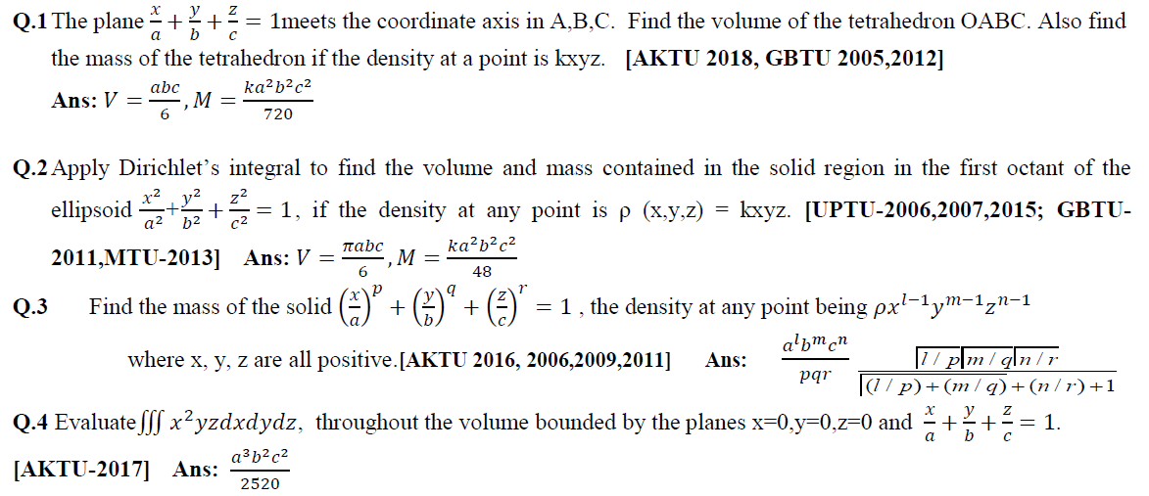
Weekly Assignment 2 (CO 1)
Dirichlet’s Integral

Slide 111
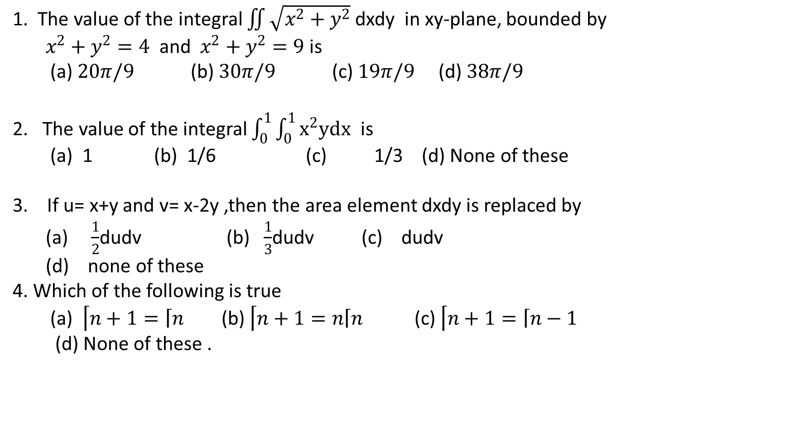
MCQ
1. The value of the integral $\iint{\sqrt{x^{2}+y^{2}}}$dxdy in xy-plane, bounded by
$x^{2}+y^{2}=4$ and $x^{2}+y^{2}=9$ is
(a) $20π/9$ (b) $30π/9$ (c) $19π/9$(d) $38π/9$
2. The value of the integral $\int_{0}^{1}{\int_{0}^{1}{x^{2}ydx }}$ is
(a) 1 (b) 1/6 (c) 1/3 (d) None of these
3. If u= x+y and v= x-2y ,then the area element dxdy is replaced by
(a) $\frac{1}{2}$dudv (b) $\frac{1}{3}$dudv (c) dudv
(d) none of these
4. Which of the following is true
(a) $\left\lceil n+1=\left\lceil n\right.\right.$ (b)$\left\lceil n+1=n\left\lceil n \right.\right.$ (c) $\left\lceil n+1=\left\lceil n\right.\right.−1$
(d) None of these .

Slide 112
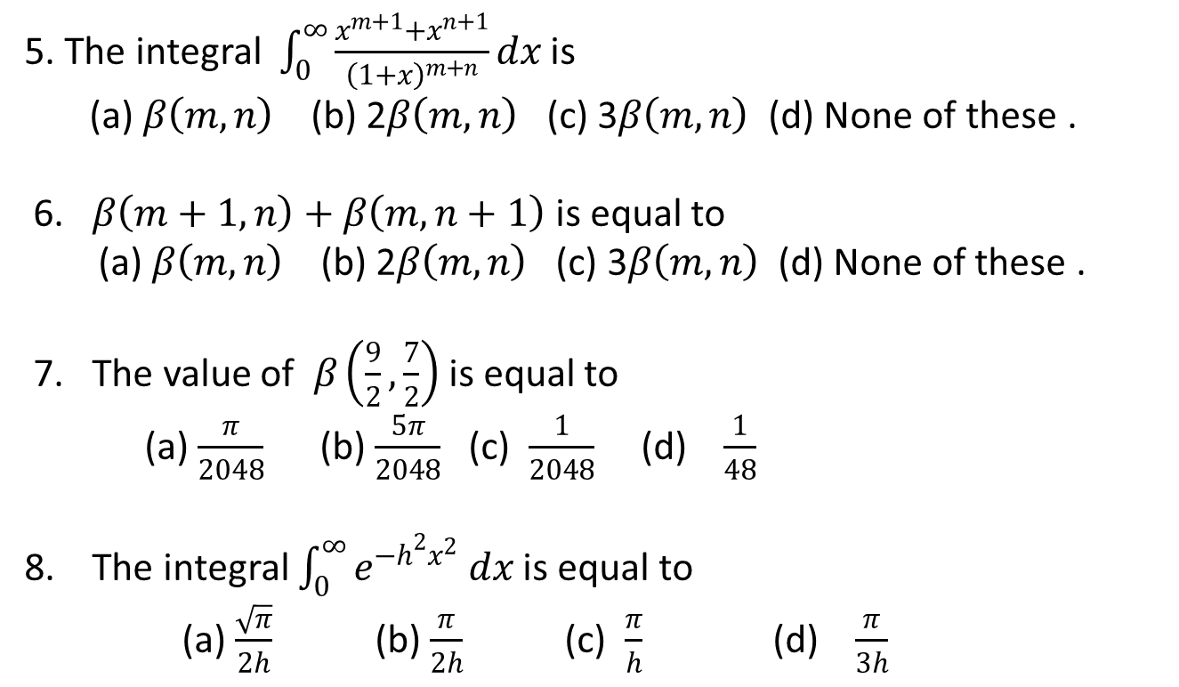
MCQ
5. The integral $\int_{0}^{∞}{\frac{x^{m+1}+x^{n+1}}{{\left(1+x\right)}^{m+n}}}dx$ is
(a) $β\left(m,n\right)$ (b) 2$β\left(m,n\right)$ (c) 3$β\left(m,n\right)$ (d) None of these .
6. $β\left(m+1,n\right)+β\left(m,n+1\right)$ is equal to
(a) $β\left(m,n\right)$ (b) 2$β\left(m,n\right)$ (c) 3$β\left(m,n\right)$ (d) None of these .
7. The value of $β\left(\frac{9}{2},\frac{7}{2}\right)$ is equal to
(a) $\frac{π}{2048}$ (b) $\frac{5π}{2048}$ (c) $\frac{1}{2048}$ (d) $\frac{1}{48}$
8. The integral $\int_{0}^{∞}{e^{−h^{2}x^{2}} dx}$ is equal to
(a) $\frac{\sqrt{π}}{2h}$ (b) $\frac{π}{2h}$(c) $\frac{π}{h}$(d) $\frac{π}{3h}$

Slide 113
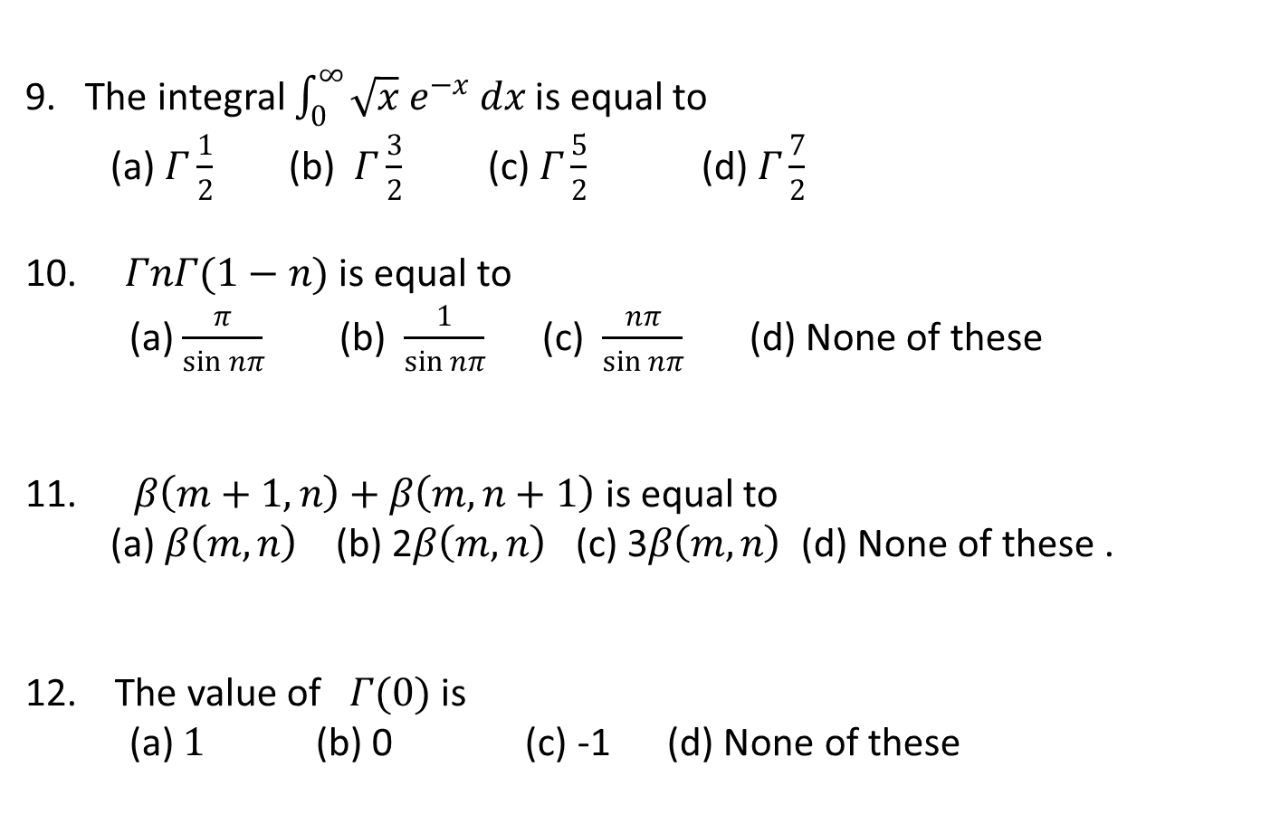
MCQ
9. The integral $\int_{0}^{∞}{\sqrt{x}{ e}^{−x} dx}$ is equal to
(a)$Γ\frac{1}{2}$(b) $Γ\frac{3}{2}$ (c)$Γ\frac{5}{2}$ (d) $Γ\frac{7}{2}$
10. $ΓnΓ(1−n)$ is equal to
(a) $\frac{π}{\sin{nπ}}$ (b) $\frac{1}{\sin{nπ}}$ (c) $\frac{nπ}{\sin{nπ}}$ (d) None of these
11. $β\left(m+1,n\right)+β\left(m,n+1\right)$ is equal to
(a) $β\left(m,n\right)$ (b) 2$β\left(m,n\right)$ (c) 3$β\left(m,n\right)$ (d) None of these .
12. The value of$Γ(0)$ is
(a) $1$(b) 0 (c) -1 (d) None of these

Slide 114
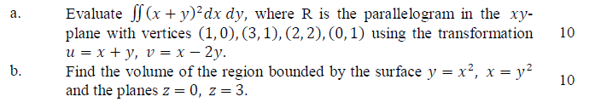
Old Year Paper-2019 (KAS-103)
Multivariable Calculus I (CO 1)
Section A
Section B
Section C

Slide 115
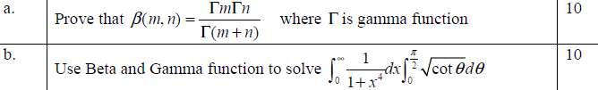
Old Year Paper 2019(KAS 203)
Multivariable Calculus I (CO 1)
Section A
Section B
Section C

Slide 116
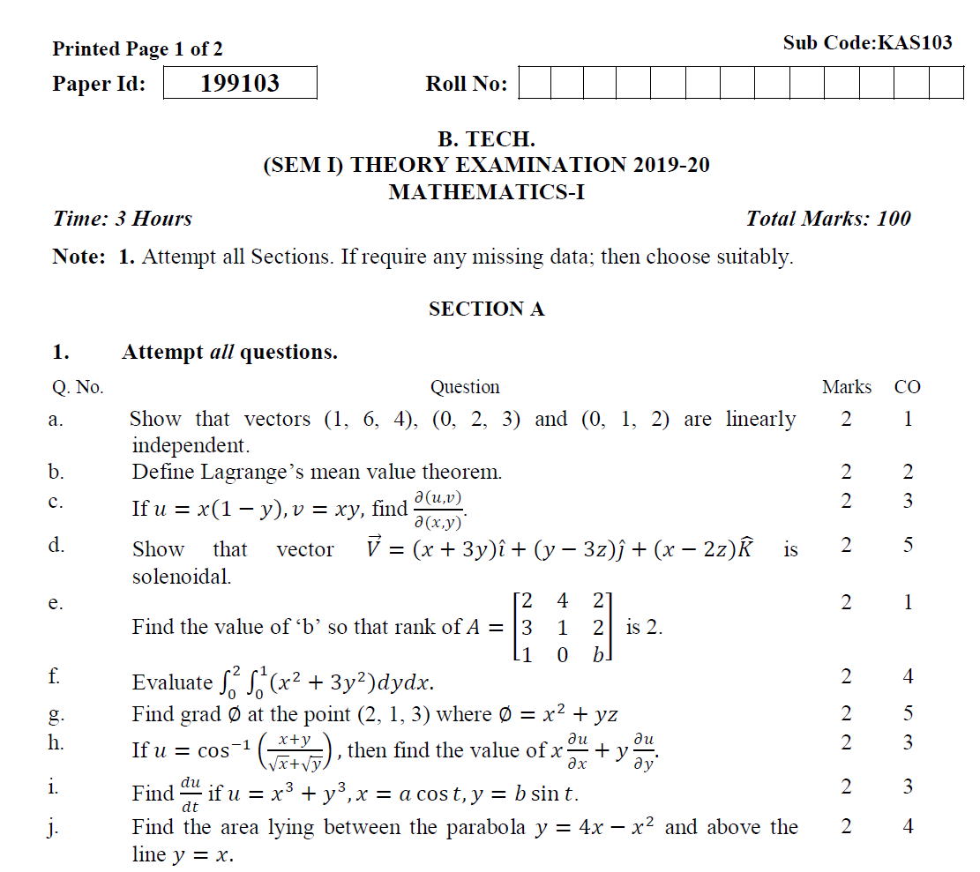
Old Year Paper 2019 (KAS-103)

Slide 117
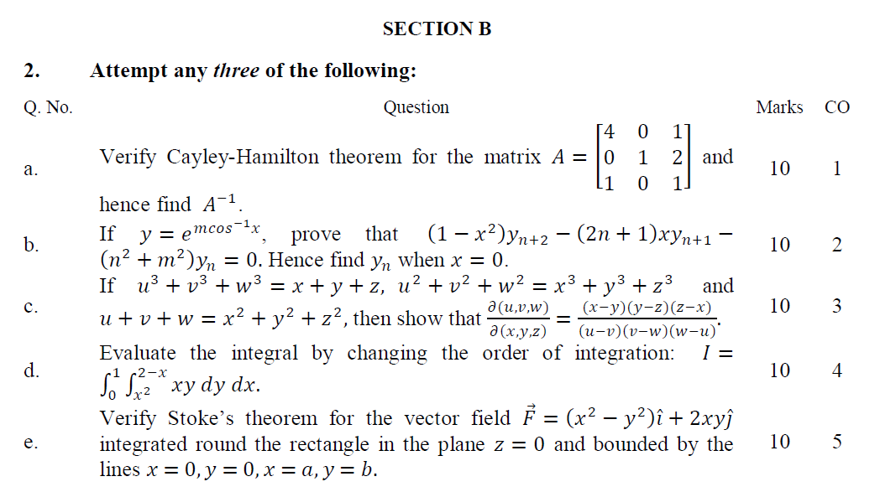
Old Year Paper 2019 (KAS-103)

Slide 118
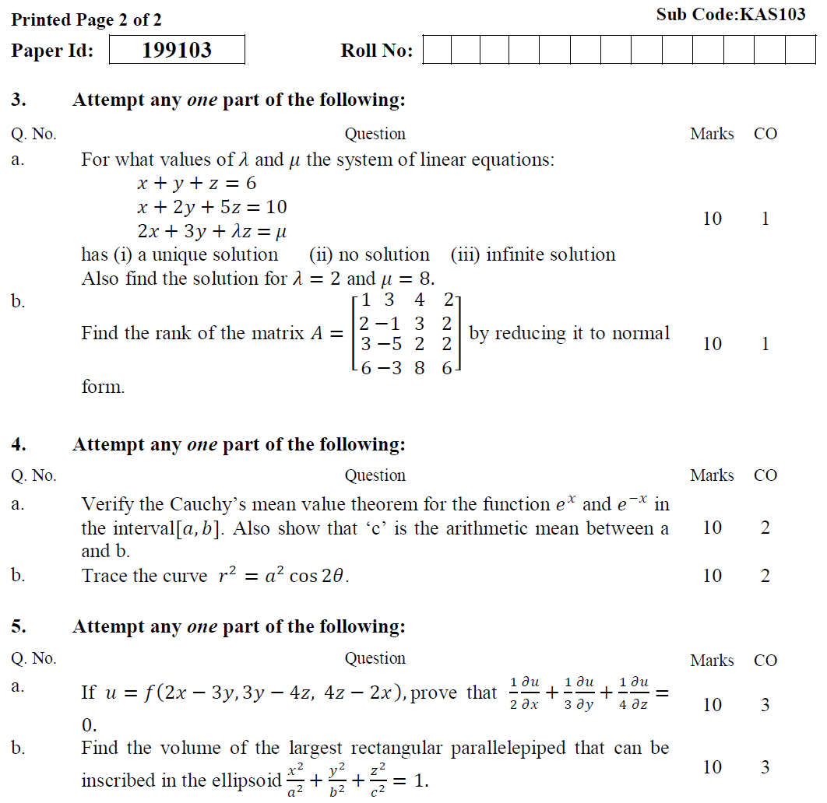
Old Year Paper 2019 (KAS-103)

Slide 119

Old Year Paper 2019 (KAS-103)

Slide 120
Old Year Paper
Links for old year papers
Mathematics I, 2019-20 (KAS-103)
http://www.aktuonline.com/papers/btech-1-sem-mathematics-1-kas103-2020.html
Mathematics I, 2018-19 (NAS-103)
http://www.aktuonline.com/papers/btech-1-sem-engineering-mathematics-1-nas-103-2018-19.html
Mathematics I, 2017-18 (RAS-103)
http://www.aktuonline.com/papers/btech-1-sem-engineering-mathematics-ras-103-2017-18.html

Slide 121

Expected Questions for University Exam
Evaluate by changing the order of integration:$\int_{0}^{1}{\int_{2y}^{2}{e^{x^{2}}}}dxdy.$
Change the order of integration and evaluate $\int_{0}^{1}{\int_{x^{2}}^{2−x}{xy dy dx}}$
State and prove the relation between beta and gamma function .
State and prove Duplication formula.
Apply Dirichlets integral to find the volume and mass of an octant of the ellipsoid $\frac{x^{2}}{a^{2}}+\frac{y^{2}}{b^{2}}+\frac{z^{2}}{c^{2}}=1$, the density at a point being $ρ=kxyz$.
Find the volume generated by revolving the ellipse $\frac{x^{2}}{a^{2}}+\frac{y^{2}}{b^{2}}=1$ about x –axis.
A solid is in the form of the positive octant of the Sphere$x^{2}+y^{2}+z^{2}=a^{2}$. The density at any point (x, y, z) is given by k xyz, where k is constant. Find mass and the co-ordinates of the centre of gravity of the solid.

Slide 122
Summary
Multiple integration
Double integral
Triple integral
Change of order of integration
Change of variables: Polar form, Spherical form, Cylindrical form
Application: Areas and volumes, Center of mass (Constant and variable densities)
Improper Integral: First Kind, Second Kind, Third Kind

Slide 123
Summary
Beta and Gama function
Dirichlet’s Integral

Slide 124
References
E. Kreyszig, Advance Engineering Mathematics, John Wiley & Sons, 2005.
Peter V. O’Neil, Advance Engineering Mathematics, Thomson (Cengage) Learning, 2007.
Maurice D. Weir, Joel Hass, Frank R. Giordano, Thomas, Calculus, Eleventh Edition,Pearson.
D. Poole, Linear Algebra : A Modern Introduction, 2nd Edition, Brooks/Cole, 2005.
Veerarajan T., Engineering Mathematics for first year, Tata McGraw-Hill, New Delhi, 2008.
Ray Wylie C and Louis C Barret, Advanced Engineering Mathematics, Tata Mc-Graw-Hill; Sixth Edition.
P. Sivaramakrishna Das and C. Vijayakumari, Engineering Mathematics, 1st Edition, Pearson India Education Services Pvt. Ltd.

Slide 125
Thank You

